Slide 1
Modeling Price of ethereum with machine learning
Scott Cilento

Slide 2
What is ethereum?
Blockchain technology
“Append only”
Used for computing power of network
Cryptocurrency called “Ether”
Famous for boom and subsequent bust in 2017-18

Slide 3
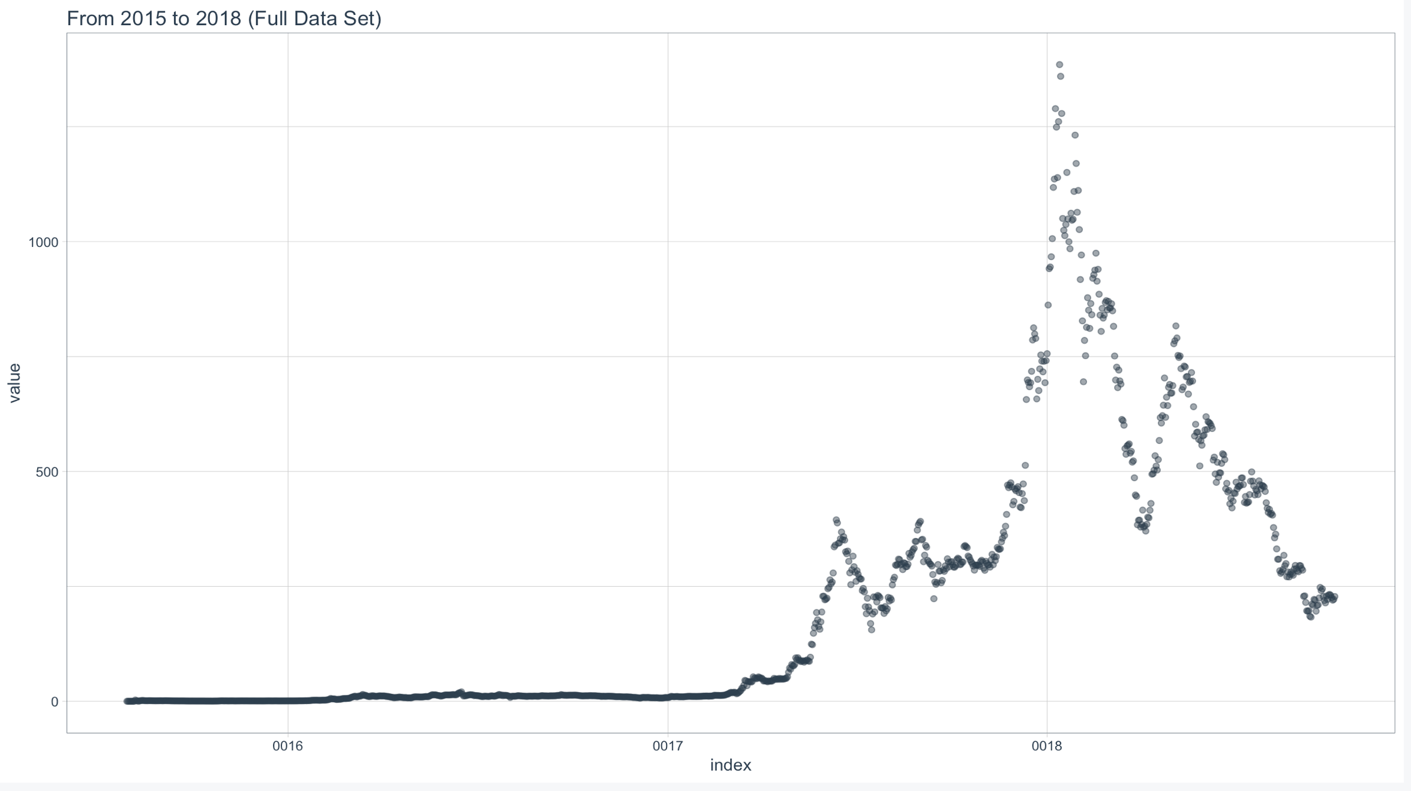

Slide 4
Dataset
July 2015 – October 2018 (1164 observations)
Blockchain attributes:
  Transactions
  Hash rate growth
  Block size (cap on processing and storage)

Slide 5
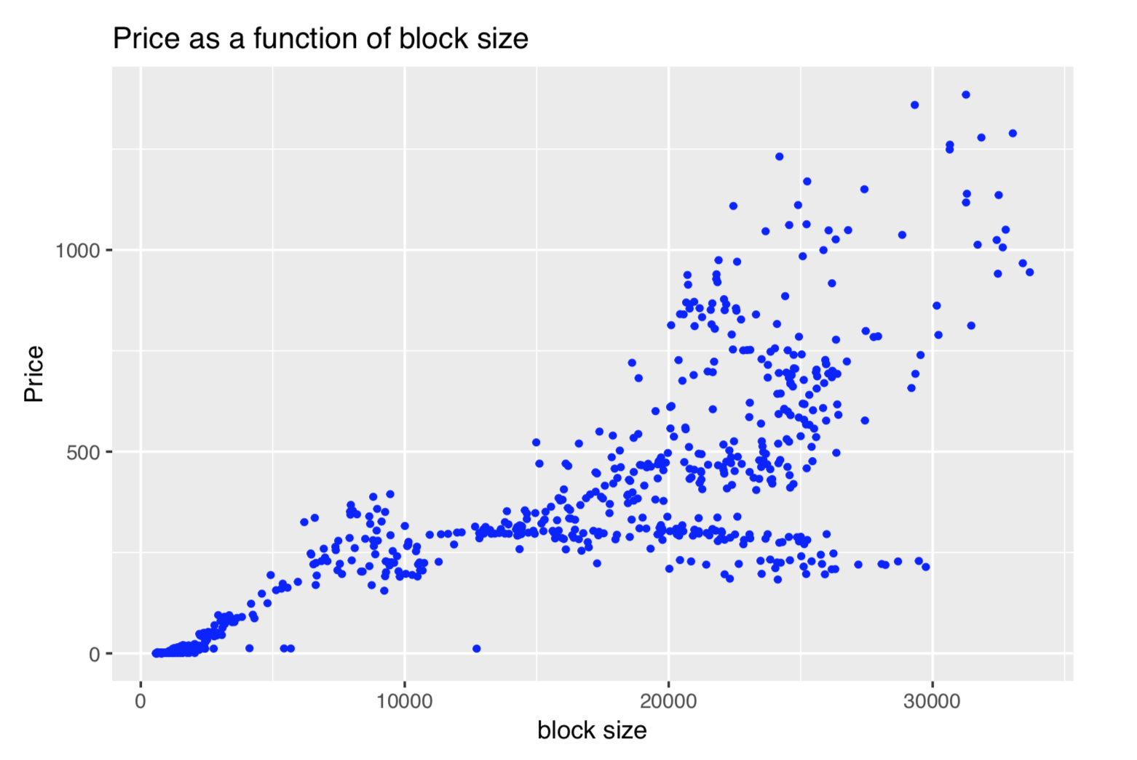
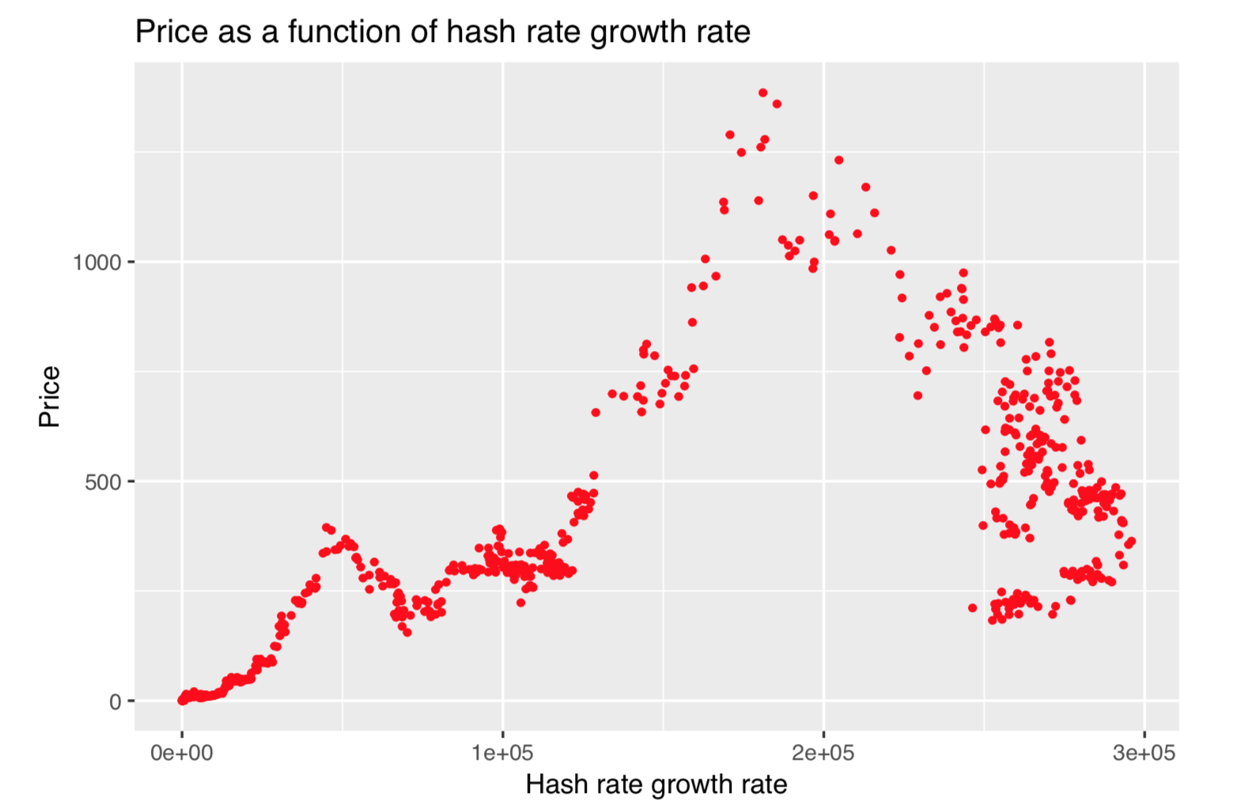
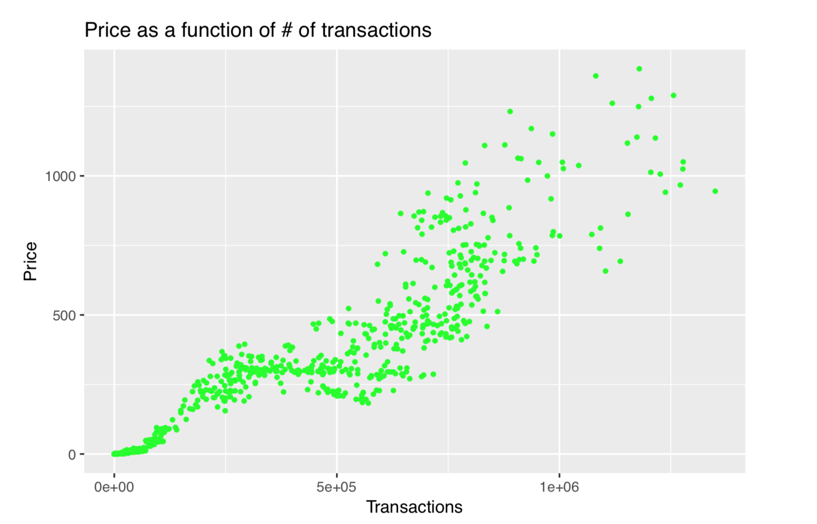
Dataset (cont.)

Slide 6
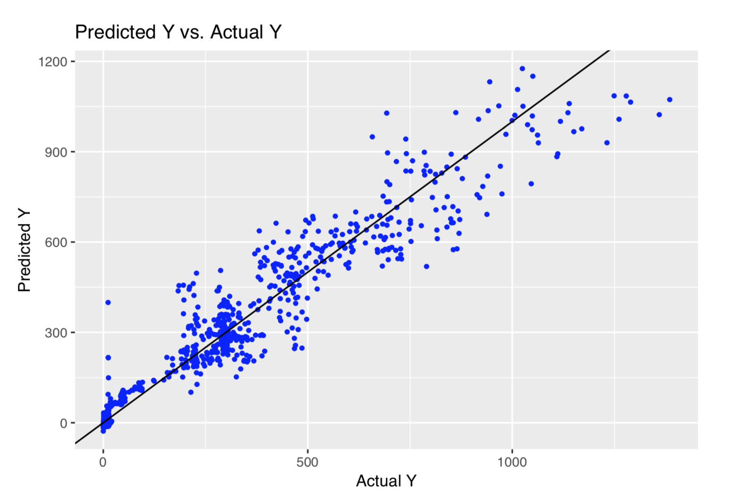
Regression

Slide 7
Price Prediction
Regression models relationships of data
Allows for prediction given transactions, growth rate, and block size
Want to predict the future price
  Strong autocorrelation from “buzz”?

Slide 8
Neural Network
Powerful, popular way to compute predictions
How does it work?
  In short: matrix multiplication
  Backpropagation, gradient descent
Source: https://www.digitaltrends.com/cool-tech/what-is-an-artificial-neural-network/

Slide 9
Neural Net and Time series
Neural net for sequential data:
  Long short-term memory network
  Inputs:
    C_{t-1} = memory from previous cell
    H_{t-1} = output of previous cell
    X_{t} = observation at t
  Outputs:
    C_{t} = memory
    H_{t} = output
Source: https://colah.github.io/posts/2015-08-Understanding-LSTMs/

Slide 10
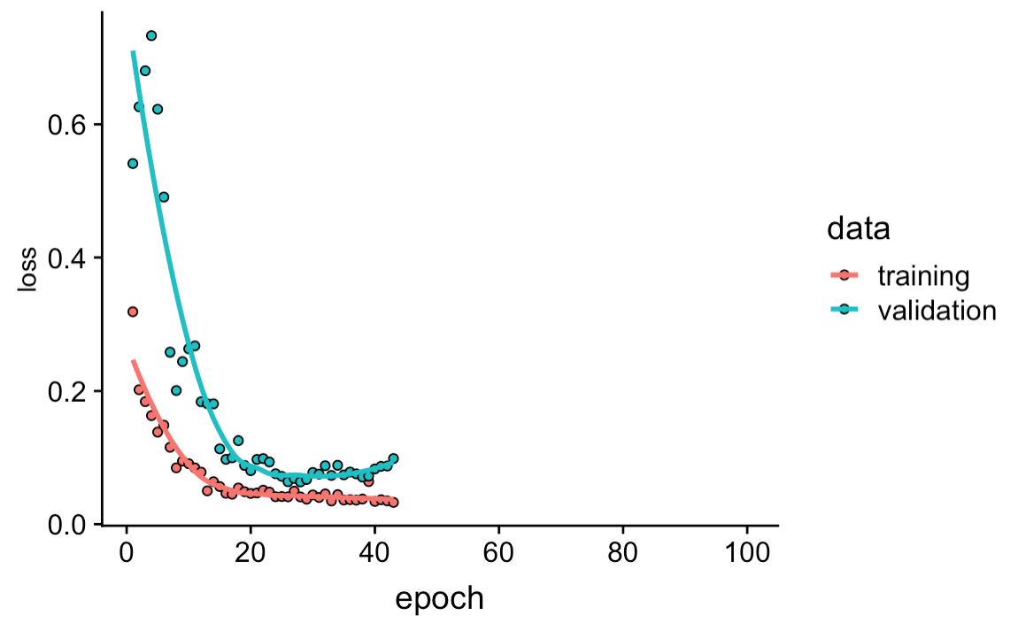
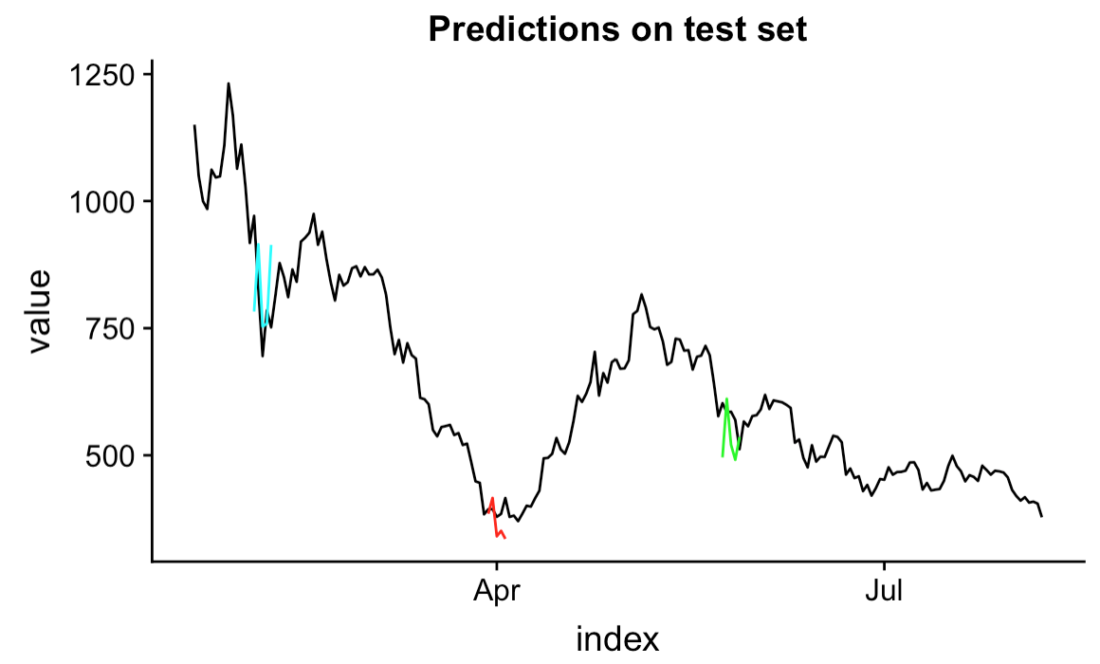
LSTM in action

